Slide 1
DDD, CQRS and Event Sourcing A practical walkthrough

Slide 2


Dennis Doomen
On an everlasting quest for knowledge that significantly improves the way you build your key systems in an agile world.
@ddoomen

Slide 3
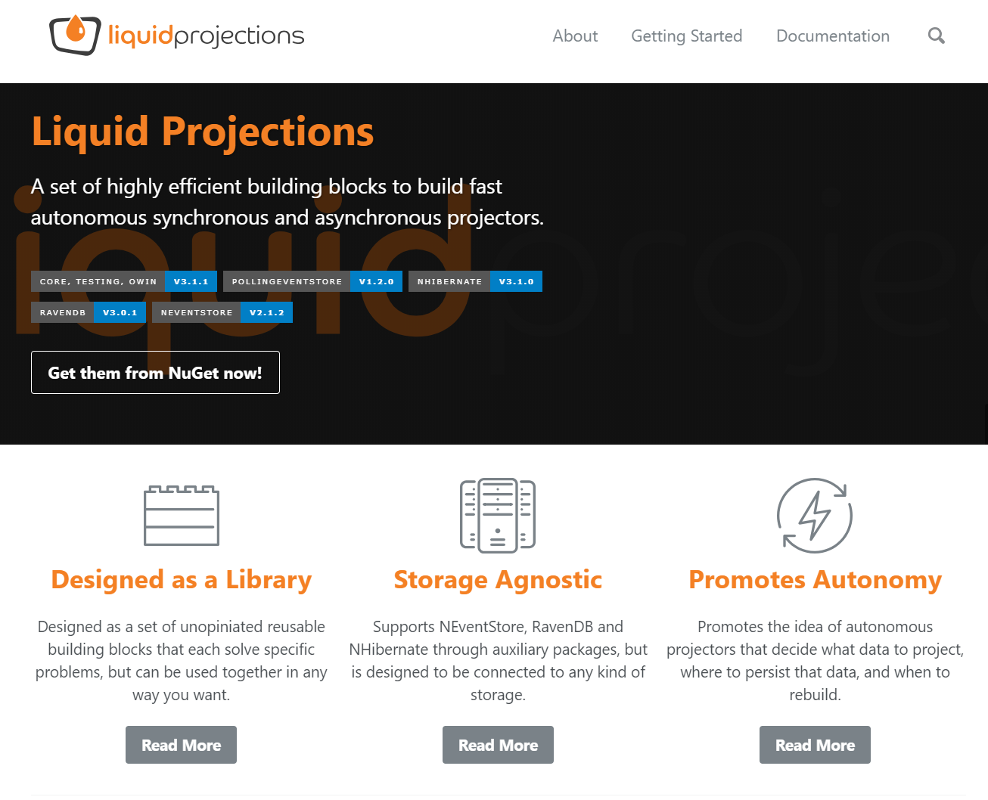
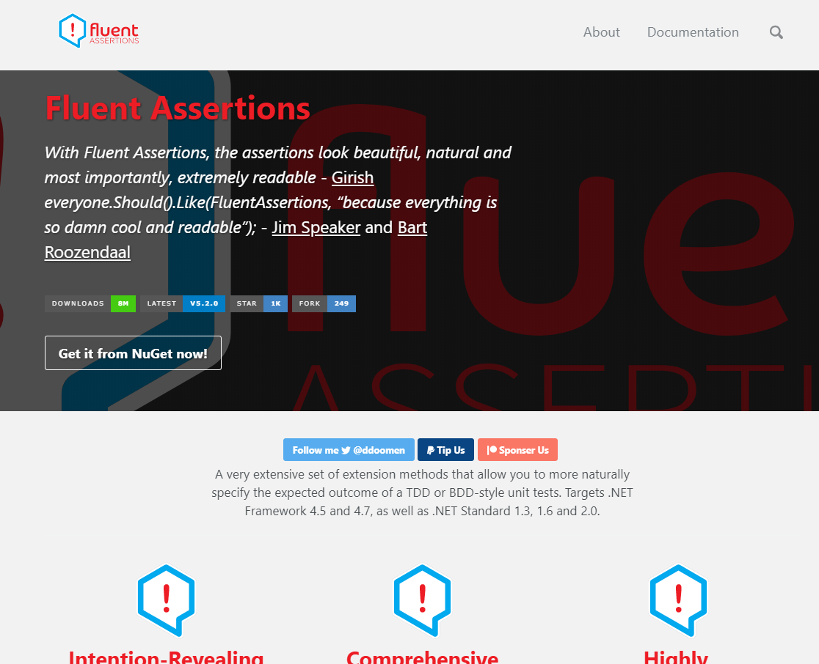
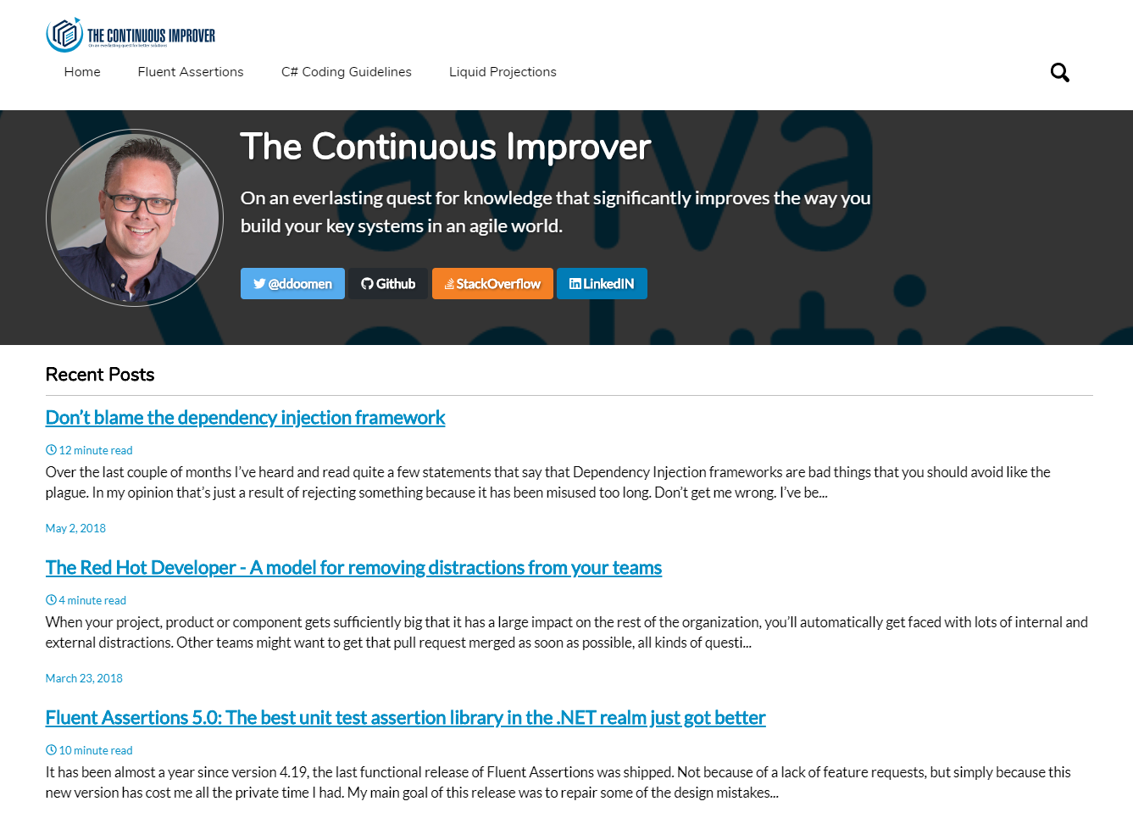
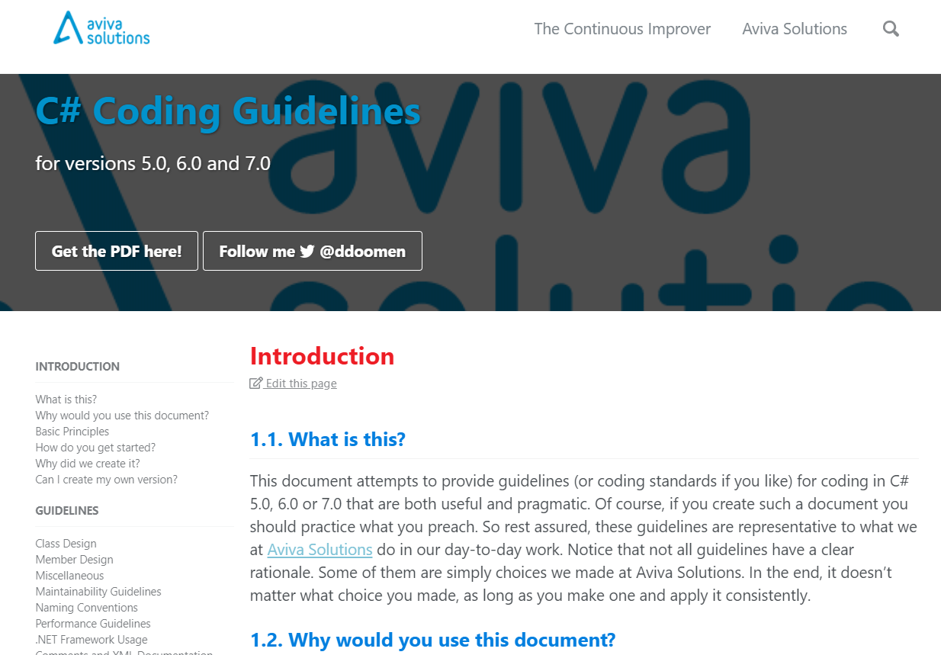
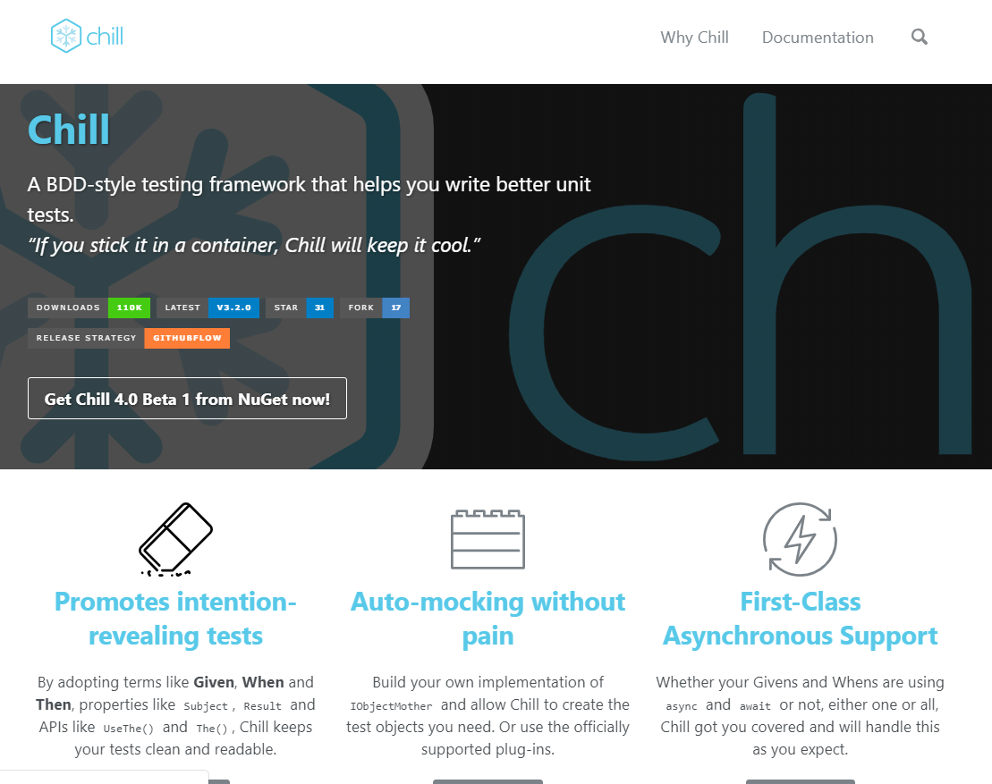

Slide 4
A modeling exercise

Slide 5


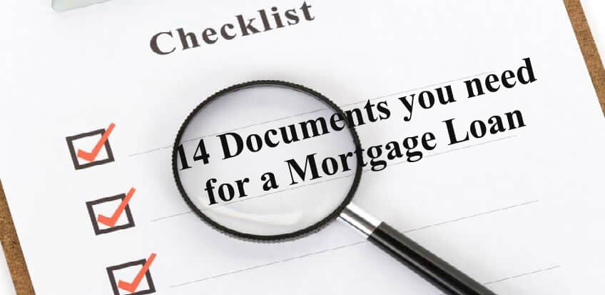
Given this domain…
Loan Officer
Mortgage Application
Proofing Documents

Slide 6
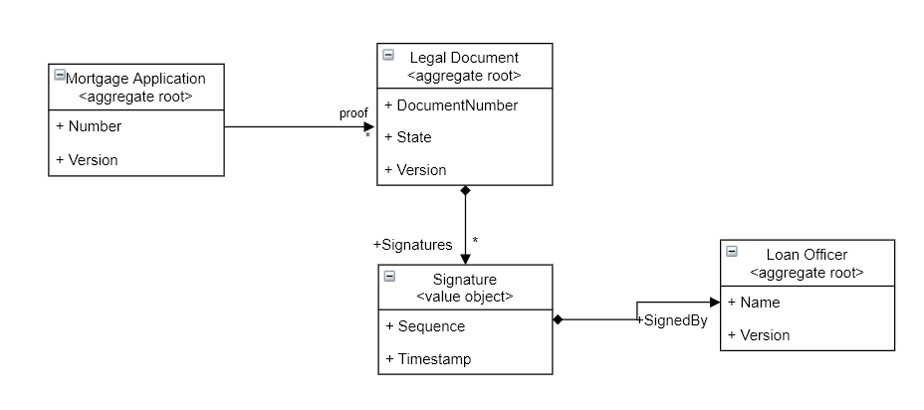
…would you model it like this?

Slide 7
Given…
…all proofing documents must have been signed before the mortgage application can be approved

Slide 8
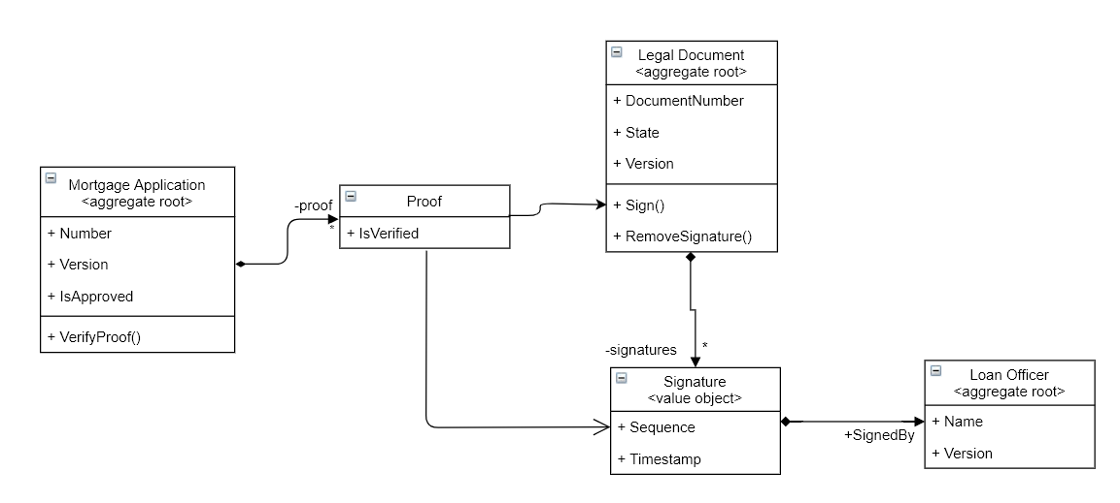
…would you use the database?
Transaction boundary to prevent tampering with proof concurrently.
Use a foreign key constraint to prevent removing signatures

Slide 9
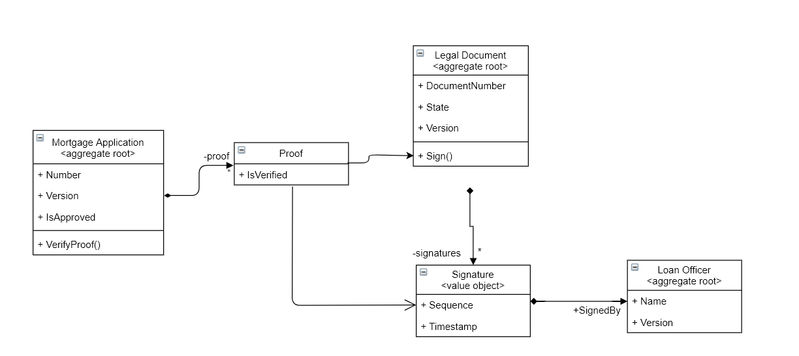
…would you solve it functionally?
No way to remove a signature.

Slide 10
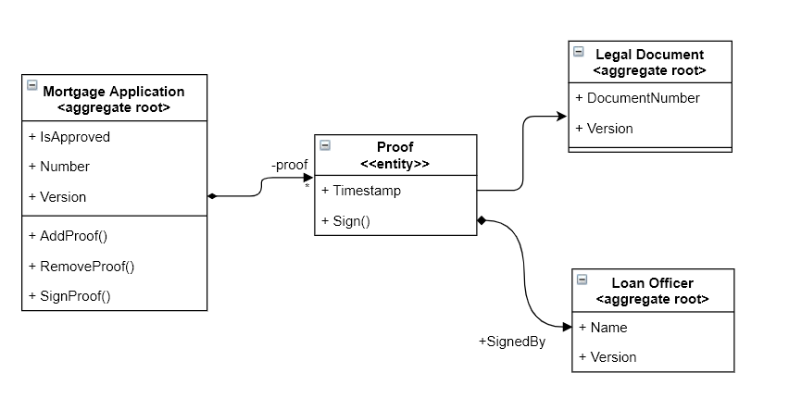
…or model around the invariants?
Bounded context
Uses the Ubiquitous Language
Protects the signatures
Aggregate boundary

Slide 11
An architecting exercise

Slide 12
Given…
…reading should be fast and collaboration is low

Slide 13
…would you use a CRUD architecture?
Web App
HTTP API
Domain
OR/M
RDBMS
Tables
(Materialized) Views

Slide 14
…maybe a NoSQL solution with fast search?
Web App
HTTP API
Domain
NOSQL
Elastic Search
Documents
Indexes

Slide 15
…and acknowledge the friction between reads and writes?
App
Use Ubiquitous Language
Commands
Query HTTP API
Command HTTP API
Command Handlers
Captures business processes
Data Access
Domain
Data Access
Elastic Search
NOSQL
Indexes
Documents
Indexes are typically eventually consistent.

Slide 16
Given this additional requirement…
…changes have to be audited

Slide 17
…would you use an audit table?
App
Commands
Query HTTP API
Command HTTP API
Data Access
Command Handlers
Domain
Data Access
Elastic Search
NOSQL
Indexes
Documents
Audit Trail

Slide 18
Given another known fact…
…many folks work on the same documents concurrently

Slide 19
…should we use Event Sourcing?
Can replay old data against new rules
App
Great unit of testing
Commands
More difficult to envisage domain relationships
Forces you to understand your domain thorogoughly
Command HTTP API
Command Handlers
Domain Model
Great unit of testing
Aligns well with Event Storming
Query HTTP API
Projectors
Events
Events
Projections
Autonomous projections
Data Access
Event Store
Can look at the state in the past
Query Store
Events
Can be scaled independently
No relational table structure anymore
Auditability comes for free

Slide 20
But does this apply to the entire system?

Slide 21
Or do we need different architectures ?
Uses traditional CRUD architecture
Application
Uses Event Sourcing
Policy Execution Domain
Drafting Domain
Web UI, HTTP API, etc
Web UI, HTTP API, etc
Domain
Projectors
Commands
Domain
OR/M / DAL
Events
Subcribe
to webhooks
Indexing-based architecture
NoSQL / RDBMS
Projections
Event Store
Search Domain
Subscribe
Web UI, HTTP API, etc
Publish coarse-grained event
Document Projector
Coarse-grained HTTP requests.
Bus
Lucene Index
Dennis Doomen | @ddoomen | Aviva Solutions | The Continuous Improver

Slide 22
A querying exercise

Slide 23
Given the following query…
…list of proofing documents with state, mortgage number and last loan officer that signed it.

Slide 24
…would you join data?
App
Joins the tables while querying
Query HTTP API
Loan Officer Projector
Mortgage Proof Projector
Event Store
Subscription
Loan Officer Projection
Mortgage Proof Projection
Data Access
Query Store
Load Officers
Proofing Documents

Slide 25
…or build a dedicated projection?
App
Can be stale. Now what?
Autonomous
Can be asynchronous
Query HTTP API
Mortgage Proof Projector
Event Store
Events
Mortgage Proof Projection
Contains state, mortgage number and loan officer info
Processes events from the mortgage and loan officer aggregates
Data Access
Query Store
Can be anything.
Proofing Document Projections

Slide 26
More real-world challenges

Slide 27
What if…
…a new version requires a schema change?

Slide 28
Out-of-place blue/green upgrade
Network Load Balancer
Returns HTTP 503 (Service Unavailable)
Returns HTTP 503 (Service Unavailable)
Version 1
Version 2
Application
bring off-line
Application
Projection
Projector
Projection
Projector
Event Store
events
Event Store

Slide 29
In-Place Upgrades
Involves down-time until projections are rebuild
Application
X
Version 1
Projector
Version 2
Event Store
Owns schema

Slide 30
What if…
…the terminology changes?

Slide 31
Evolve the event schema.
HTTP Command API
Some Command Handler
Customer Enrolled Event
May split or merge events
Get<Customer>(“123”)
Customer #123
Can also run as part of migration
Customer Created Event Converter
Unaffected Events
May change the identity
Event Store
Customer Created Event
Dennis Doomen | @ddoomen | The Continuous Improver

Slide 32
What if…
…there’s a bug in a projection?

Slide 33
Or…
…rebuilding a projection is slow?

Slide 34
..then build fast autonomous projectors
Event Store
Subscribe
Stream-by-stream projections during rebuilds.
Subscribe
Subscribe
Autonomous & independent
Use aggressive caching during rebuilds.
Projector
Projector
Projector
NHibernate
Raw SQL
RavenDB
RDBMS
RDBMS
Document DB
Storage technique optimized for projection
Caching strategy optimized for projector

Slide 35
What if…
…we have 4 years of data and rebuilding is still too slow?

Slide 36
…then archive older events
Deletes projections related to Document #1
Graph Projector
Tracks dependencies between documents
Document #1 Closed Event
Projector with active projections
Start archiving
(other events)
Document #1
Can skip all archivable events during next rebuild.
Document #1 Created Event
Marked As Archivable Event
Archiving Projector
Mark all events as archivable
Event Store

Slide 37
…or even delete old events
Application
Search
Search.
Document Projector
Lucene Projector
Lucene Index
Allows projectors to clean up
Marked As Archivable Event
Take snapshot
Tombstone
Stream Tombstoned Event
Document #1
Tracks deleted streams for future references
Purge events
$tombstone stream
Event Store

Slide 38
What if…
…need to capture the original name of a loan officer while signing?

Slide 39
…then use lookups
Subscribes to events from loan officers and documents
Projector
Event Store
Subscription
Loan Officer Lookup
Projection

Slide 40
…or enrich the events during projection
Project loan officer events
(persistent)
Lookup
Receives modified events
Subscription
Projector
Event Modifier
Event Store
Subscription
Modifies events with lookup data
Storage

Slide 41
But what if I run into something else…
…then ping me at @ddoomen
…or email me at dennis.doomen@avivasolutions.nl

